Slide 1

Zero Day Attack

Slide 2
Topics
What is Zero Day Attack?
Preventing Zero Day Attacks
How to protect yourself from Zero Day Attack?
Conclusion
Types of Zero Day Attacks
Detecting Zero Day Attacks
Examples of Zero Day Attacks

Slide 3

What is Zero Day Attack ?
A zero day attack is a malicious attack that exploits an unknown vulnerability in a computer system or software.
It is a type of cyber attack where the attacker takes advantage of a vulnerability before the target has had a chance to patch or address the vulnerability.

Slide 4
What is Zero Day Attack ?
What is Zero Day Attack ?
Zero day attacks are difficult to detect and prevent because they happen before the vulnerability is known.
This means that traditional security measures such as antivirus software, firewalls, and intrusion detection systems may not be able to detect the attack.

Slide 5
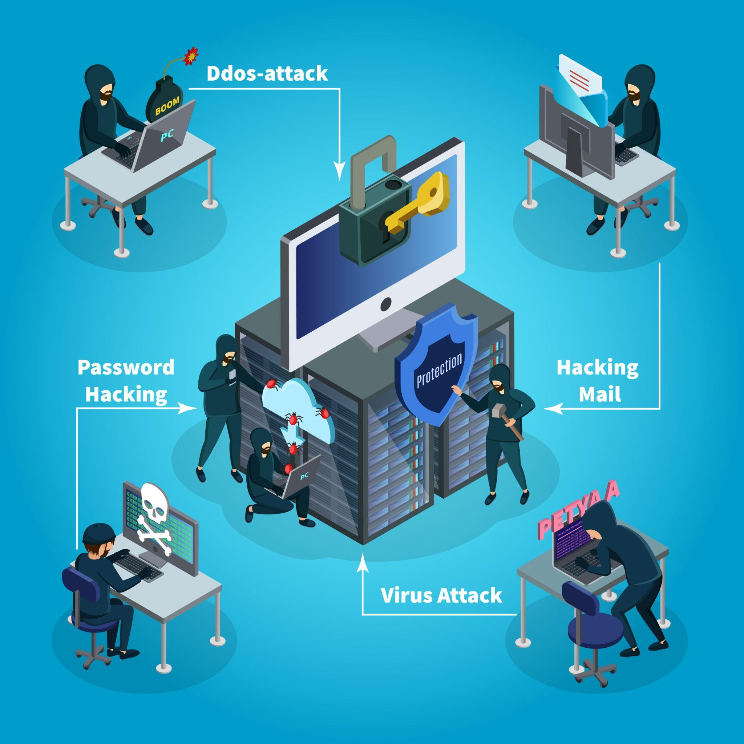
Types of Zero Day Attacks
Remote code execution
Denial of service
Privilege escalation
Zero day attacks can take many forms, including malware, phishing, and ransomware which can be used to steal sensitive information or to gain access to a system.
Other types of zero day attacks include buffer overflow attacks, remote code execution, denial of services, and privilege escalation attacks

Slide 6
Types of Zero Day Attacks
Remote code execution is a cyber-attack whereby an attacker can remotely execute commands on someone else’s computing device.
Denial-of-service (DoS) A Denial-of-Service (DoS) attack is an attack meant to shut down a machine or network, making it inaccessible to its intended users.
Privilege escalation Privilege escalation refers to the process of gaining access to higher levels of system privileges or permissions than what is initially granted to a user or program.

Slide 7
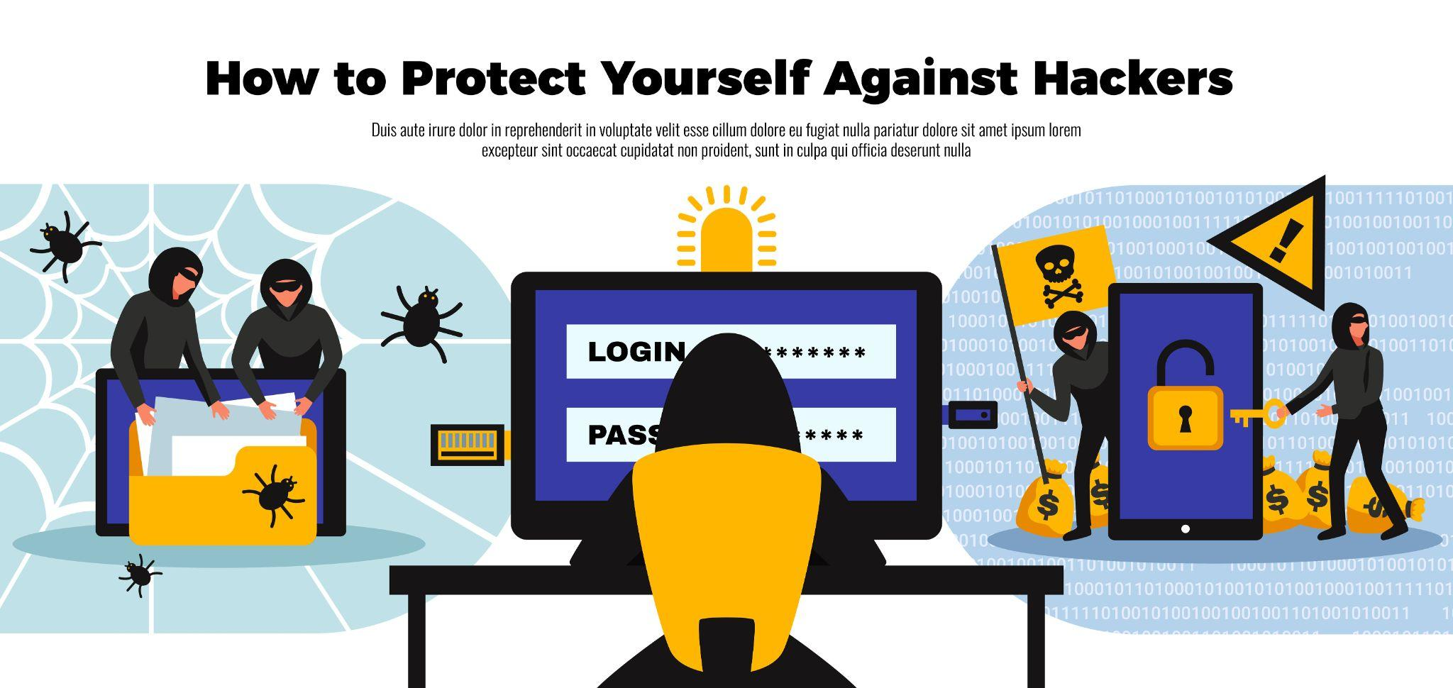
Preventing Zero Day Attacks
Preventing zero day attacks requires a proactive approach to security.
This includes patching and updating systems regularly, as well as implementing security measures such as firewalls and intrusion detection systems.

Slide 8
Preventing Zero Day Attacks
Organizations should also implement best practices such as limiting user privileges, using strong passwords, and monitoring user activities.
Additionally, organizations should implement a comprehensive security awareness program to educate users on the risks associated with zero day attacks.

Slide 9
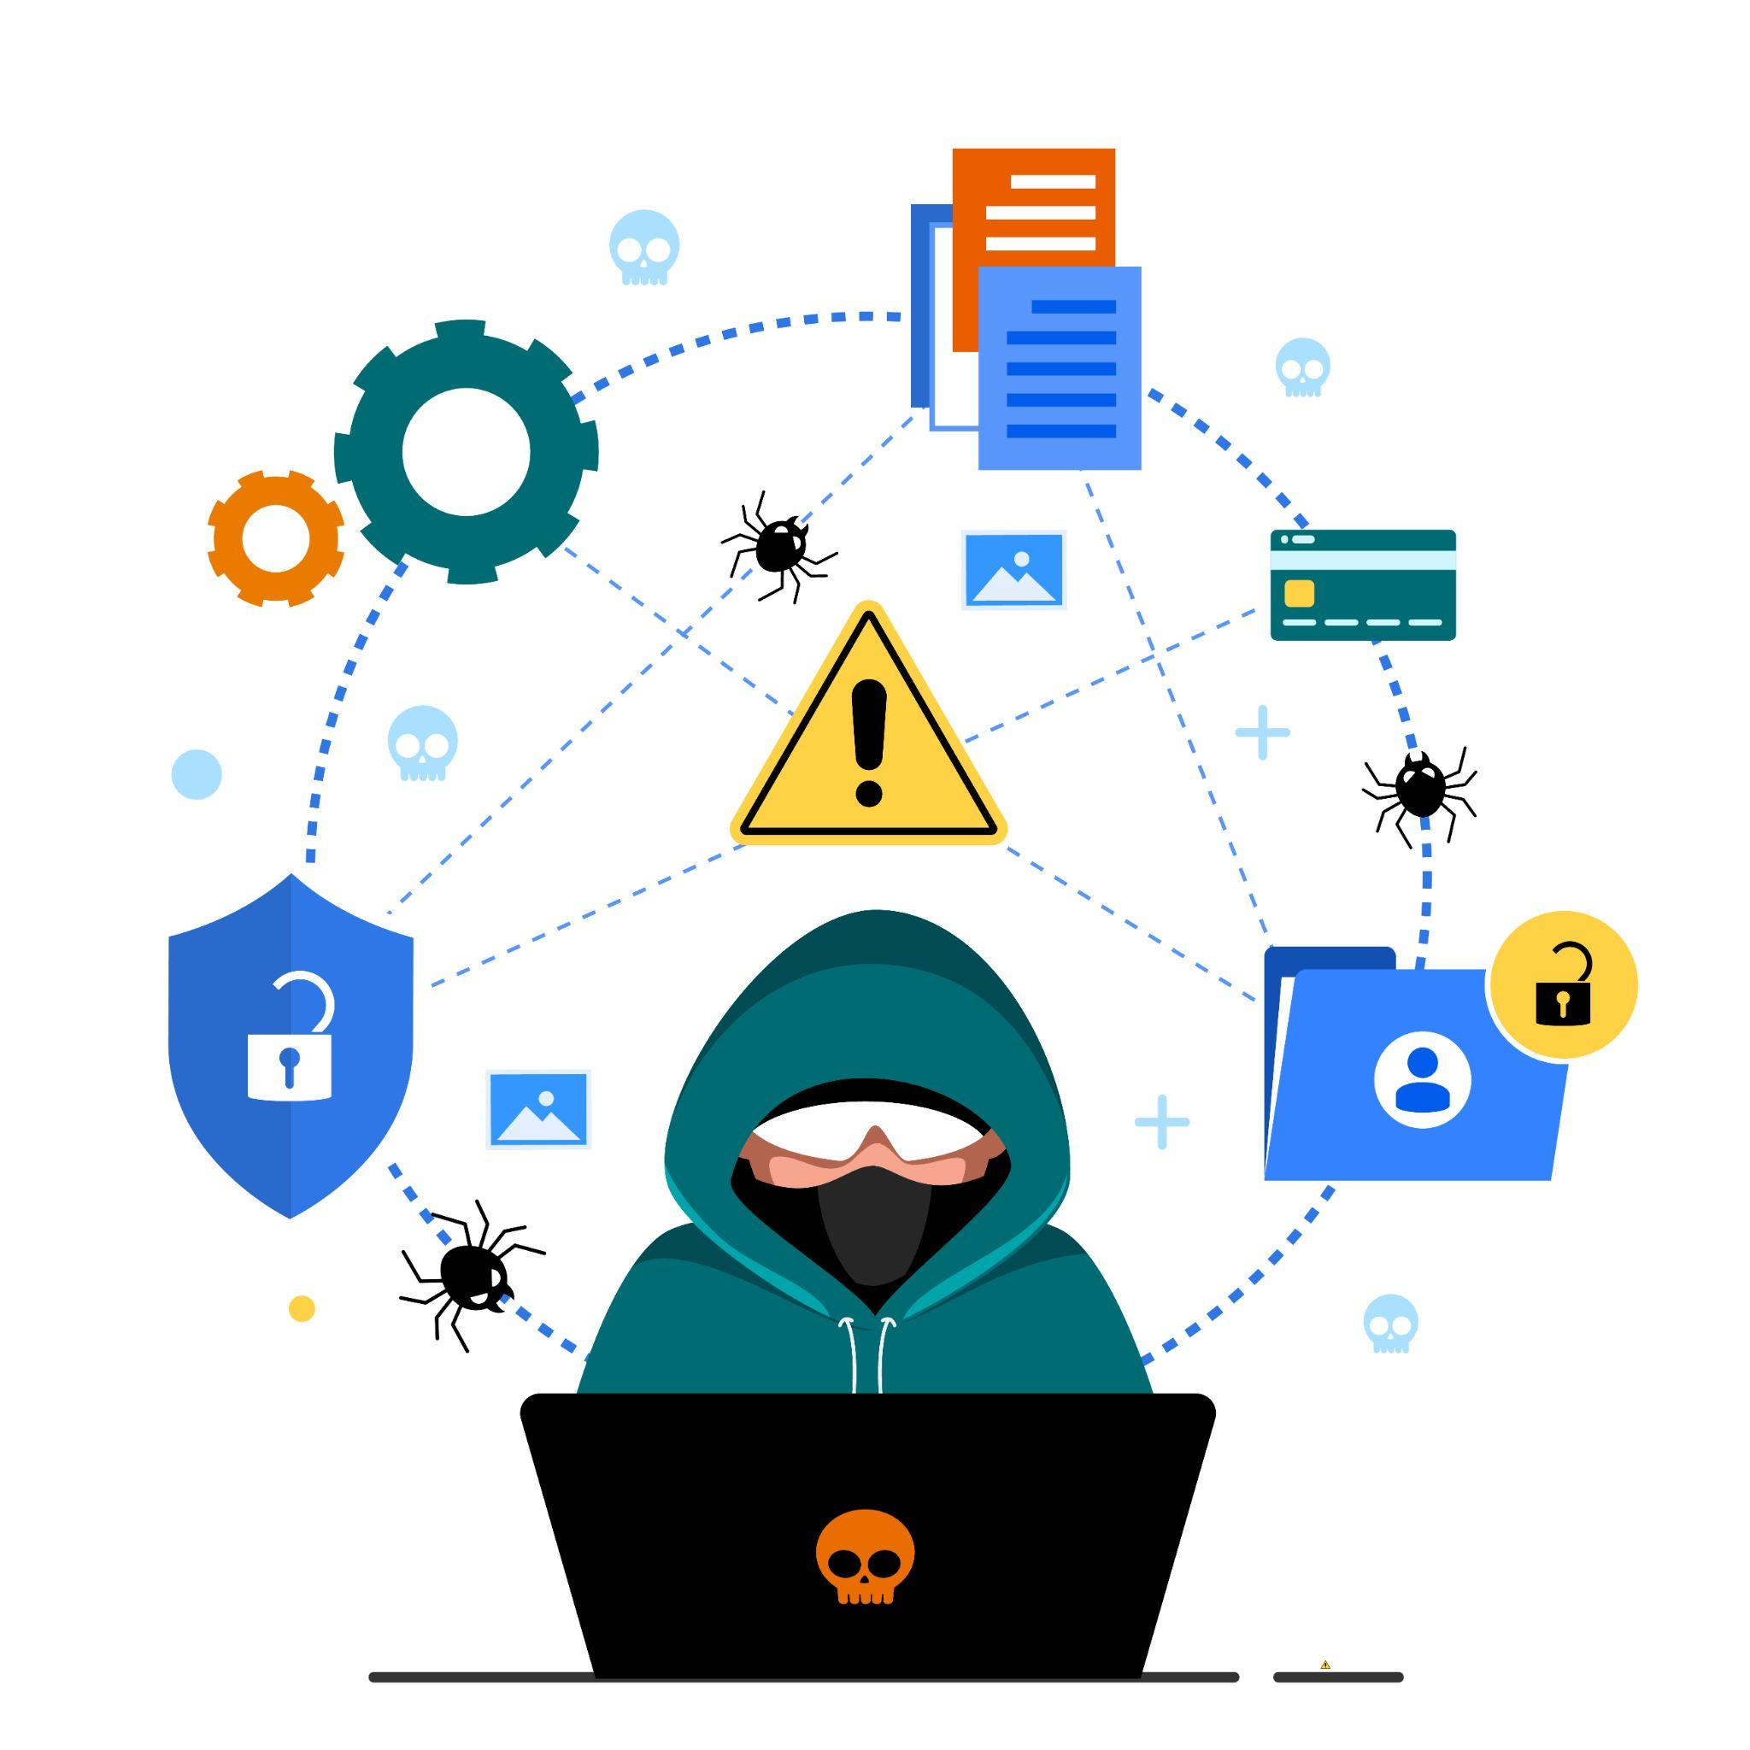
Detecting Zero Day Attacks
Detecting zero day attacks can be difficult because they occur before the vulnerability is known.
However, organizations can use a variety of tools and techniques to detect and respond to zero day attacks.
These include using intrusion detection systems, honeypots, and sandboxing.

Slide 10
Detecting Zero Day Attacks
Organizations should also monitor system logs for suspicious activity and use network traffic analysis to detect anomalies.
Additionally, organizations should use threat intelligence to identify potential threats and vulnerabilities.

Slide 11

How to protect yourself against Zero Day Attacks ?
Keep all software and operating systems up to date.
Use only essential applications.
Use a firewall.
Within organizations, educate users.
Use a comprehensive antivirus software solution.

Slide 12
Example of Zero Day Attacks
Some recent examples of zero-day attacks include
2021: Chrome zero-day vulnerability -
In 2021, Google's Chrome suffered a series of zero-day threats, causing Chrome to issue updates. The vulnerability stemmed from a bug in the V8 JavaScript engine used in the web browser.

Slide 13
Example of Zero Day Attacks
Some recent examples of zero-day attacks include
2020: Zoom
A vulnerability was found in the popular video conferencing platform. This zero-day attack example involved hackers accessing a user’s PC remotely if they were running an older version of Windows. If the target was an administrator, the hacker could completely take over their machine and access all their files.

Slide 14
Example of Zero Day Attacks
Some recent examples of zero-day attacks include
2020: Apple iOS
Apple’s iOS is often described as the most secure of the major smartphone platforms. However, in 2020, it fell victim to at least two sets of iOS zero-day vulnerabilities, including a zero-day bug that allowed attackers to compromise iPhones remotely.

Slide 15

Conclusion
Zero day attacks are a serious threat to organizations, and they can have devastating consequences.
Even organizations like Google, Zoom, Apple and many more such companies are a threat to these attacks
By taking the necessary safety steps, organizations can protect themselves from zero day attacks and reduce their risk of a successful attack.

Slide 16



Group-20
Simone Gracias
Lyann Henriques
Shruti Humbal
Thankyou

